Slide 1
CGT620 lab5
Jichun Zheng

Slide 2
Final Output

Slide 3
Implementation thoughts
Use implicit method
Generate a random cutting plane that perpendicular to the given random fault plane
The cutting plane is expressed implicitly as:
a( x - x0 ) + b( y - y0 ) + c( c - c0 ) = 0;
Where: { a , b, c } is the normal of the cutting plane
{ x0, y0, z0 } is a known point on the plane
{ x, y, z } is a point on the random fault plane that to be tested on which side of the cutting plane

Slide 4
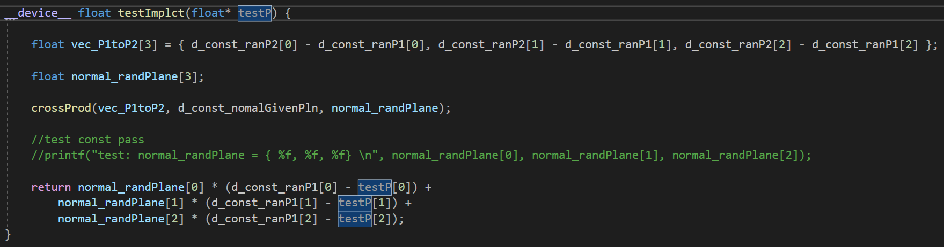
A test function called by kernel
Input: a point
Output: On which side of the plane is this point?
If > 0 on the right side, if =0 on the plane, if < 0 on the left side

Slide 5
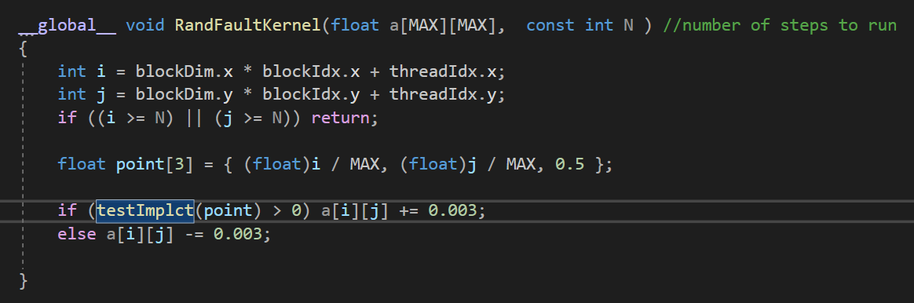
Kernel Function
In Kernel, call the test() for each point on the random fault plane
Change the height of the grid depending on the output of test function

Slide 6
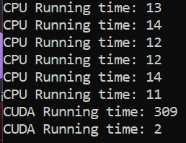
Performance
CPU takes 13(+-1)ms to compute random fault
GPU takes 309ms for the first time (lazy allocate)
After that it’s 1ms ~2ms

